Slide 1


ITC — Information Technology Colleague
رواد مصر الرقمية
GRADUATION
PROJECT
Powerful • Modern • Premium
React
E-Commerce Platform
2025 / 2026
SHR4_SWD2_S1
React الشرقية
شكر وتقدير لإدارة المبادرة ولشركة ITCالشركة المنفذة لتراك Reactالشرقية

Slide 2
Overview
AGENDA
What we'll cover today
This presentation introduces Marketly, a modern E-Commerce platform built using React, Firebase Authentication, and Cloud Firestore. It covers the project objectives, architecture, key features, implementation process, and final results.
01 Introduction
02 Problem Statement
E-Commerce
React
Firebase
Firestore
03 Solution Overview
04 System Design
Project Type
Frontend
Backend Services
Database
05 Demo
06 Conclusion

Slide 3
Project Overview
Team · Tech Stack · Supervisor
The Team
Project Name
Marketly
Sohaib Ayman
Rawan Hamdi
S
R
Team Leader
Frontend Developer
Tech Stack
React, Redux Toolkit, Firebase Authentication, Cloud Firestore, React Router, Formik & Yup, Bootstrap
Hossam Hassan
Abdelrahman Khaled
H
A
Frontend Developer
Frontend Developer
Supervisor
ITC
Mohamed Ahmed
M
Frontend Developer

Slide 4
PROBLEM
Problem
01
Product Management
Managing products and keeping data consistent across the platform can be challenging.
Statement
Modern online stores need a reliable way to manage products, orders, and users while providing a smooth shopping experience.
Many solutions depend on external data sources, lack real-time updates, or make order management difficult for administrators.
02
Order Tracking
Customers need a simple way to track their orders and follow delivery progress.
03
Data Reliability
Dependence on external APIs may cause data inconsistencies and system instability.

Slide 5
Proposed Solution
Marketly provides a complete E-Commerce solution with product management, order tracking, user authentication, and administrative tools powered by Firebase and Firestore.
SOLUTION
Main Solution
Key Features
Developed a full-featured E-Commerce platform that enables users to browse products, place orders, and track deliveries while giving administrators complete control over products, users, and orders.
User Authentication & Roles
Product Catalog & Categories
Search, Filters & Sorting
Order Tracking System
Admin Dashboard
Backup & Restore Tools
Technologies
Expected Outcomes
React
Redux Toolkit
Firebase Authentication
Cloud Firestore
React Router
Bootstrap
Reliable product management
Real-time data synchronization
Secure user access control
Simplified order management
Improved shopping experience

Slide 6



System
1. Architecture
React Frontend
Firebase Services
Cloud Firestore
2. Components
User Interface
Admin Dashboard
Authentication & Orders
3. Data Flow
User Action
Firebase Processing
Firestore Storage
Design
Frontend
Backend
Database
React
Redux Toolkit
React Router
Bootstrap
Firebase Auth
Firestore APIs
Role Control
Users
Products
Orders
Categories

Slide 7
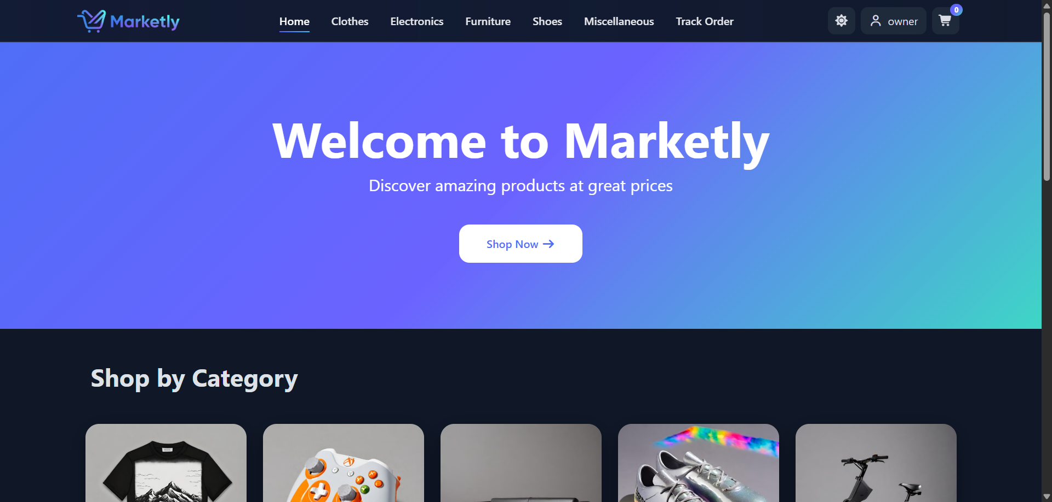
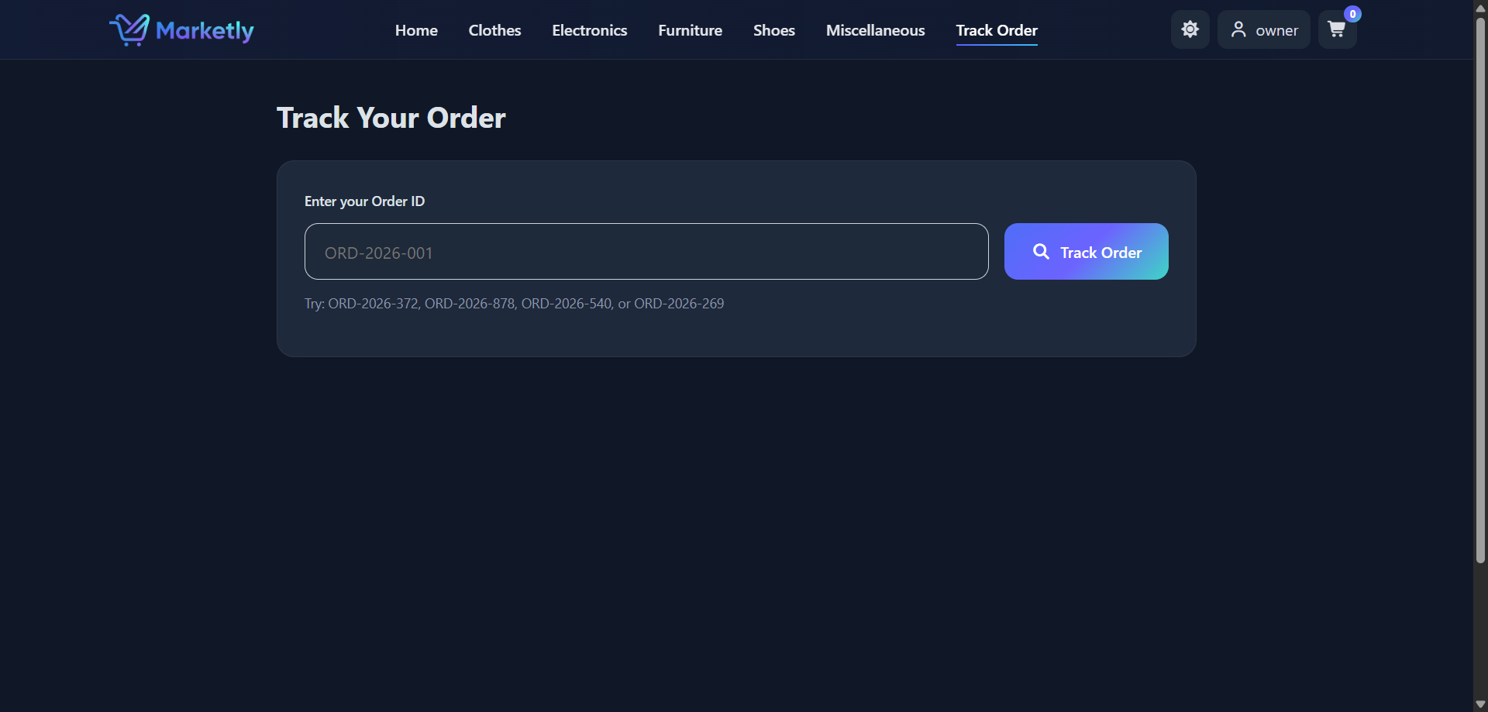
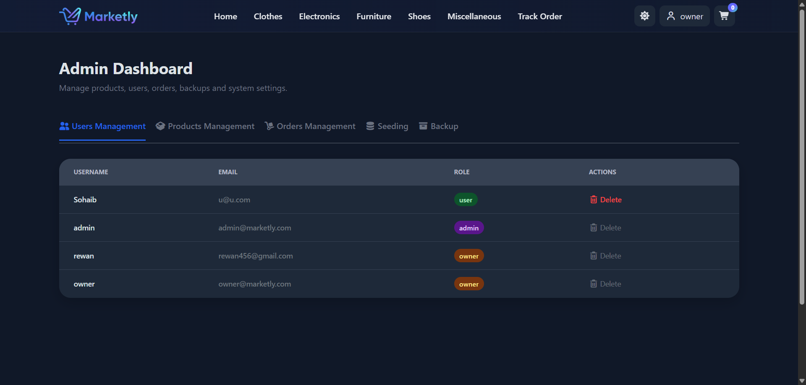
Demo &
Screenshots
1
Key Screens from Marketly Platform

Slide 8
Performance Validation
Google Lighthouse Audit Results
88
93
96
100
Performance
Accessibility
Best Practices
SEO

Slide 9
Conclusion
Summary
Thank
Marketly provides a complete e-commerce solution
with product management, order tracking,
and administrative control through a modern
and user-friendly web application.
You!
Learnings
Working with React & Redux Toolkit
Firebase Authentication & Firestore Integration
State Management & Performance Optimization
Team Collaboration & Project Deployment
Sohaib Ayman — Team Leader
ITC Graduation Project
Future Work
Product Reviews & Ratings
Wishlist Functionality
Advanced Search & Filtering
Real-time Notifications

